Slide 1


Code Foo 2017
Michael c. velez ii
3/18/2017

Slide 2

Introduction https://youtu.be/LJ3UExh3xR0

Slide 3
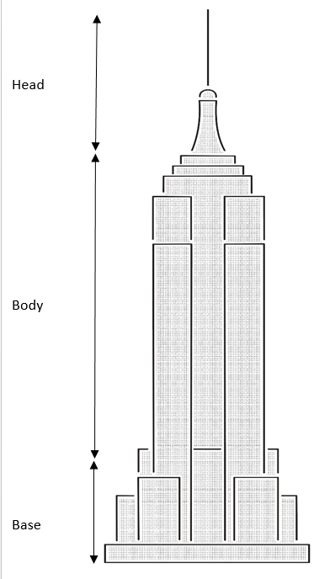

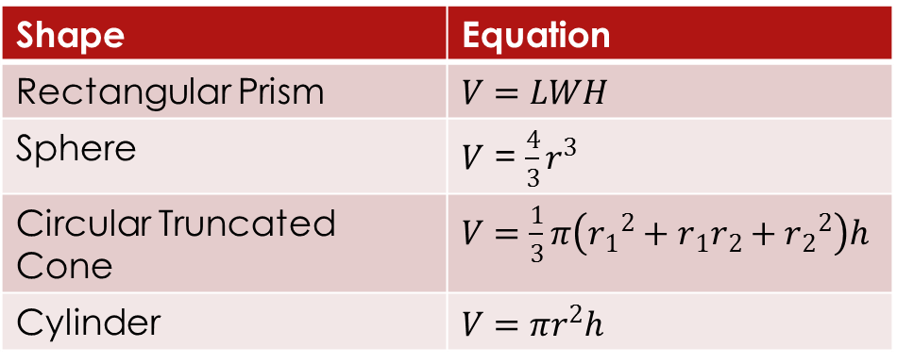
Empire State Building Problem
I immediately pictured the Empire State Building and recalled that its structure resembles several 3D rectangular boxes and squares which are all stacked to create its overall shape. At the top of the building I am presuming we have a flat conical shape topped by half of a sphere and then a thin, tubular shape. Since this is a very large building, I will consider the line to be like a stack of many cube shapes. This reminded me of the design principle of “modularity” or separation of concerns.
In order to solve the larger problem at hand we must first divide it into smaller problems. Using this knowledge, we can break down the schematics of the building into individual pieces which can then be solved to find cubic volume of each piece. Below are the equations we will need.
Shape | Equation
Rectangular Prism | $V=LWH$
Sphere | $V$ = $\frac{4}{3}r^{3}$
Circular Truncated Cone | $V=\frac{1}{3}π\left({r_{1}}^{2}+r_{1}r_{2}+{r_{2}}^{2}\right)h$
Cylinder | $$V=πr^{2}h$$

Slide 4

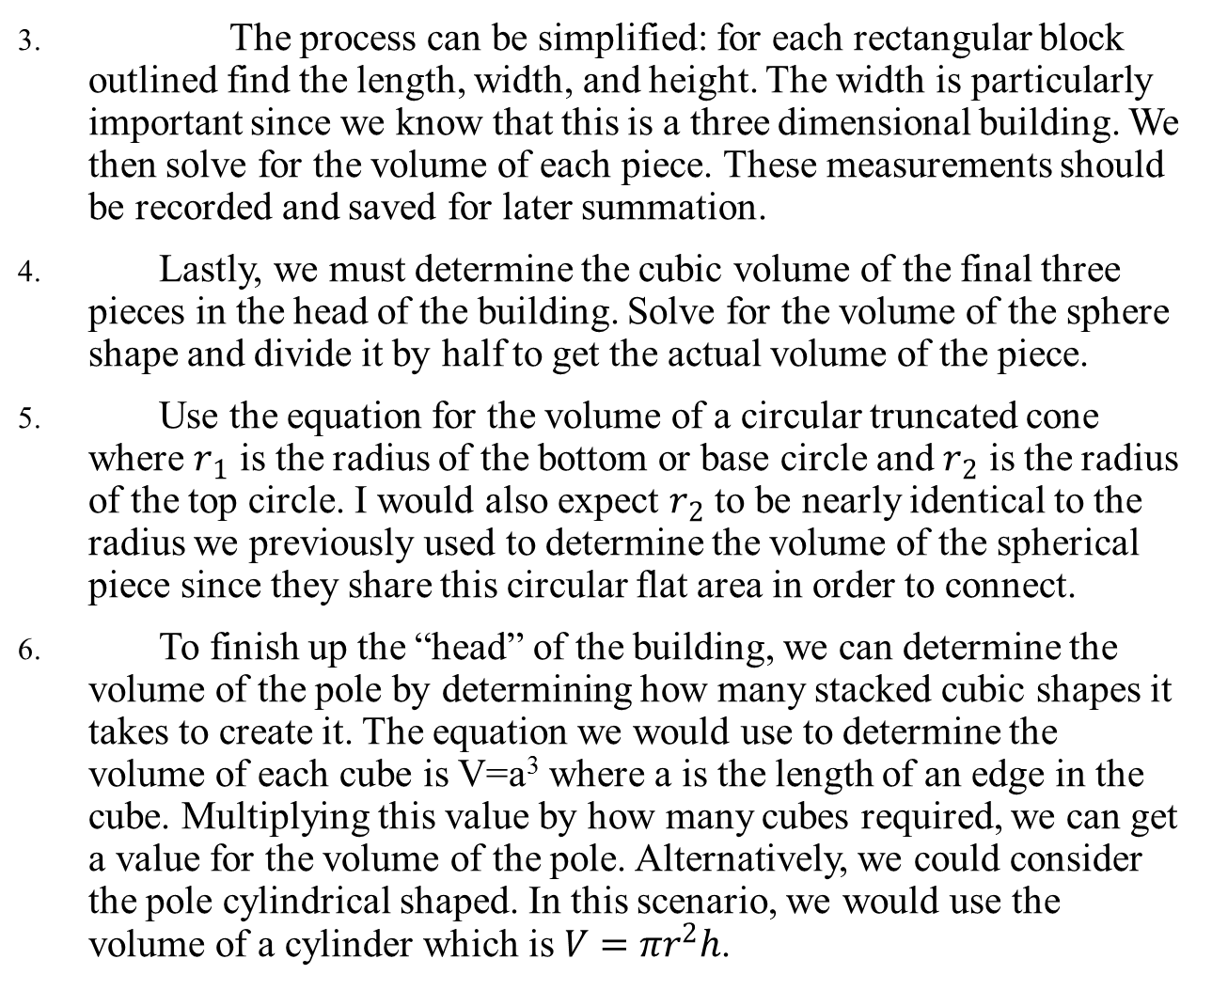
The process can be simplified: for each rectangular block outlined find the length, width, and height. The width is particularly important since we know that this is a three dimensional building. We then solve for the volume of each piece. These measurements should be recorded and saved for later summation.
Lastly, we must determine the cubic volume of the final three pieces in the head of the building. Solve for the volume of the sphere shape and divide it by half to get the actual volume of the piece.
Use the equation for the volume of a circular truncated cone where $r_{1}$ is the radius of the bottom or base circle and $r_{2}$ is the radius of the top circle. I would also expect $r_{2}$ to be nearly identical to the radius we previously used to determine the volume of the spherical piece since they share this circular flat area in order to connect.
To finish up the “head” of the building, we can determine the volume of the pole by determining how many stacked cubic shapes it takes to create it. The equation we would use to determine the volume of each cube is V=a³ where a is the length of an edge in the cube. Multiplying this value by how many cubes required, we can get a value for the volume of the pole. Alternatively, we could consider the pole cylindrical shaped. In this scenario, we would use the volume of a cylinder which is $V=πr^{2}h$.

Slide 5
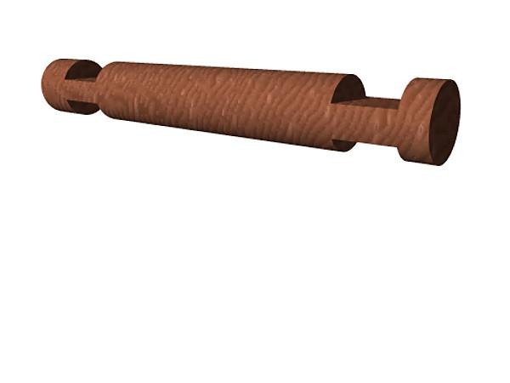
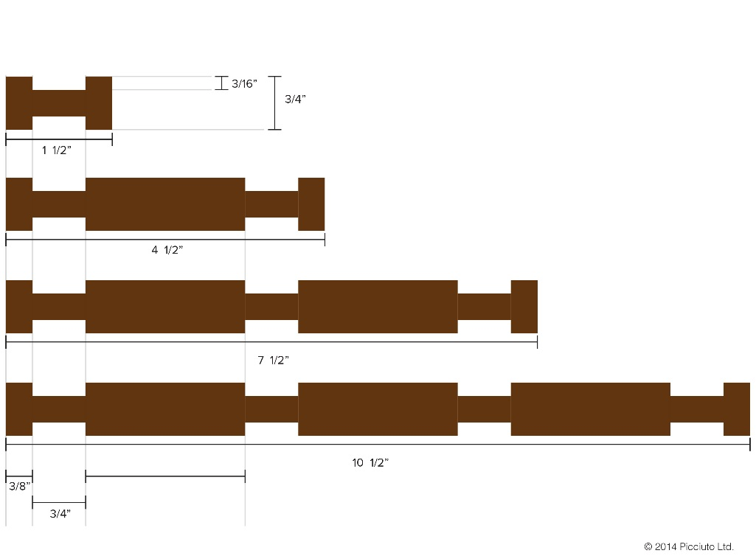
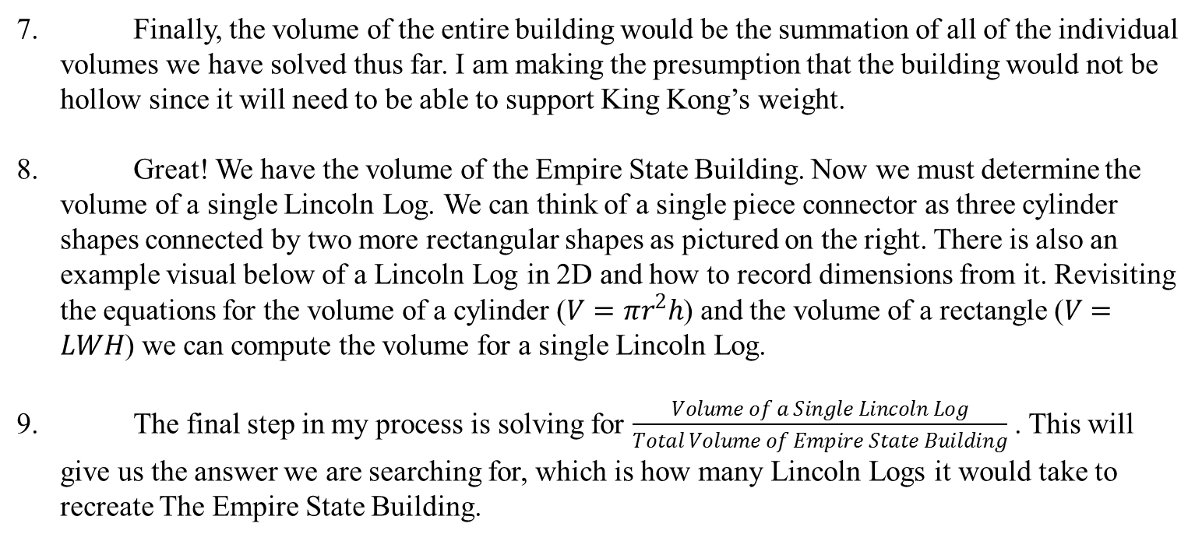
Finally, the volume of the entire building would be the summation of all of the individual volumes we have solved thus far. I am making the presumption that the building would not be hollow since it will need to be able to support King Kong’s weight.
Great! We have the volume of the Empire State Building. Now we must determine the volume of a single Lincoln Log. We can think of a single piece connector as three cylinder shapes connected by two more rectangular shapes as pictured on the right. There is also an example visual below of a Lincoln Log in 2D and how to record dimensions from it. Revisiting the equations for the volume of a cylinder ($V=πr^{2}h$) and the volume of a rectangle ($V=LWH$) we can compute the volume for a single Lincoln Log.
The final step in my process is solving for $\frac{Volume of a Single Lincoln Log}{Total Volume of Empire State Building}$ . This will give us the answer we are searching for, which is how many Lincoln Logs it would take to recreate The Empire State Building.

Slide 6
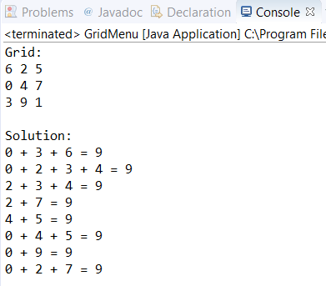
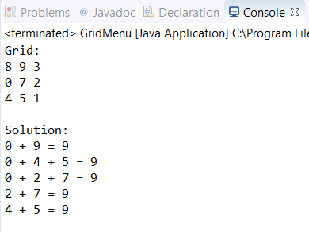
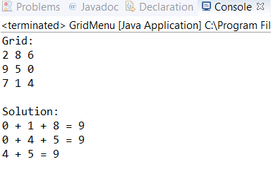
Grid Problem
For source code, please see my GitHub Repository “IGN_Code_Foo” at https://github.com/Michaelgoku/IGN-Code-Foo-7
Screenshots:
Run #1 Run#2 Run#3

Slide 7
Q: Explain how you implemented the solution.
A: I chose to use two 2D arrays, one to represent my numbered grid, one boolean matrix to track the path taken by a chain and two different types of lists to represent an individual chain (a list of integers) and final solution (a list of lists of integers). I chose to use lists so that I had access to the methods in the List Interface which would make manipulating these chains and identifying duplicates a lot easier. I later sorted my list of chains and then converted it to a set to remove duplicates. I then converted it back to a list for my final solution.
I began by taking pen to paper and writing out all the different steps and variables that I could think of that this program would need. Similarly to my thought process in the Empire State Building question, I wanted to break down my overall problem into as many smaller problems as possible. These eventually became my individual functions.
After identifying and writing out the pseudo code for this process, I knew that there would be one main function which handles the majority of the processing of a single cell. This turned out to be my recursionGrid function. I knew that this would have to be a recursively called function in order to process adjacent cells. I would say that this was the most difficult part for me to develop until I realized that I needed to create copies of my boolean grid and the chain which was currently being tested, and pass them as parameters to the same function in order to process adjacent cells.
If I could develop this program again, I would consider making my program more object-oriented by making an individual cell an object, which contains its coordinates and a boolean value to track whether it has been visited or not. This would replace my boolean matrix which I use to track visited cells.

Slide 8
Q: Can you make a version with a larger grid?
A: Yes, my program can handle larger grids. I kept in mind that although the problem required a 3 x 3 grid, I would want to test a grid with a larger scale. I wanted my program to be adaptable to any sized grid. In order to do this, I used variable names whenever possible instead of “magic numbers”. I have learned that randomly appearing numbers in a program (aka magic numbers) negatively impact its readability and maintainability. So, for example, instead of solving for the sum of 9 in an individual chain, I solved for the variable gridArea which is calculated upon the variable’s initialization at the top of my program based on length x width. For the sake of this application, I set these dimensions to 3 x 3. If I wanted to enhance my program, I would introduce a scanner which reads input from the user for both length and width before building the grid and finding a solution.

Slide 9
Q: How well does it scale?
A: My program performs well for single and double digit lengths/widths, however, there are usually far fewer solutions or sometimes none at all for double digit dimensions. Once triple digit dimensions are tested, the code takes much longer to execute. On a single run, it took over 2 minutes and returned zero solutions. I believe this could be because it is much more difficult to find a valid solution as the size of the grid increases. I also realized that my code only handles lengths and widths that match (n x n). This is something I only realized while testing the grids scalability.

Slide 10
Front End Problem
For source code, please see my GitHub Repository “FrontEnd” at https://github.com/Michaelgoku/IGN-Code-Foo-7
Additional Features:
In the original design, when a panel is clicked it is replaced with the thumbnail of the article or video. I chose to keep the panel’s title and description in my design because I felt that the original took away from the user’s visibility of what the article or video was about. Some of the thumbnails aren’t obvious enough to give the user this information with the title being removed. Instead, I opted for a design with collapsible panels. This way when a user clicks the panel, the thumbnail extends and all information is kept visible.
Some of the sub-headlines and video descriptions were too long to fit in the panel’s dimensions. I wanted to offer a way to allow the user to still be able to read this information without sacrificing design and having to boost the dimensions too much or shrink the fonts. Instead, I added the functionality that allows the user to hover the mouse over the thumbnails which then displays the descriptions/sub-headlines. In particular, the videos description allows the user to see information that was otherwise unavailable to them. In the original design, only the title and “long title” were visible to the user.
Since the design provided did not demonstrate what the articles section looked like, I saw this as an opportunity to think up a design myself. I went to IGN.com to see what metadata is usually displayed when listing articles. I found that there’s usually a “time since” following the articles’ headline, followed by the articles’ description. I added this to my design.

Slide 11
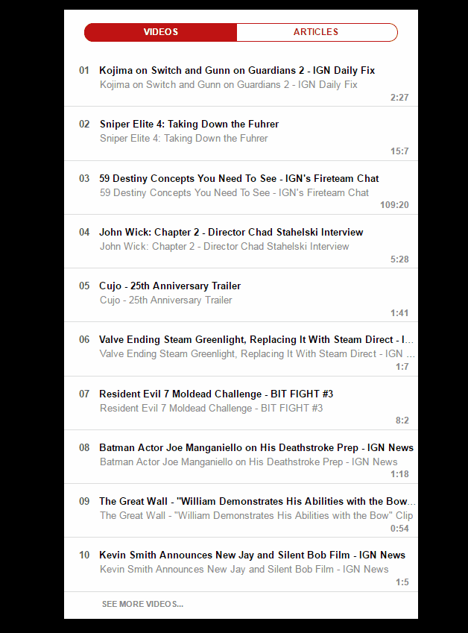
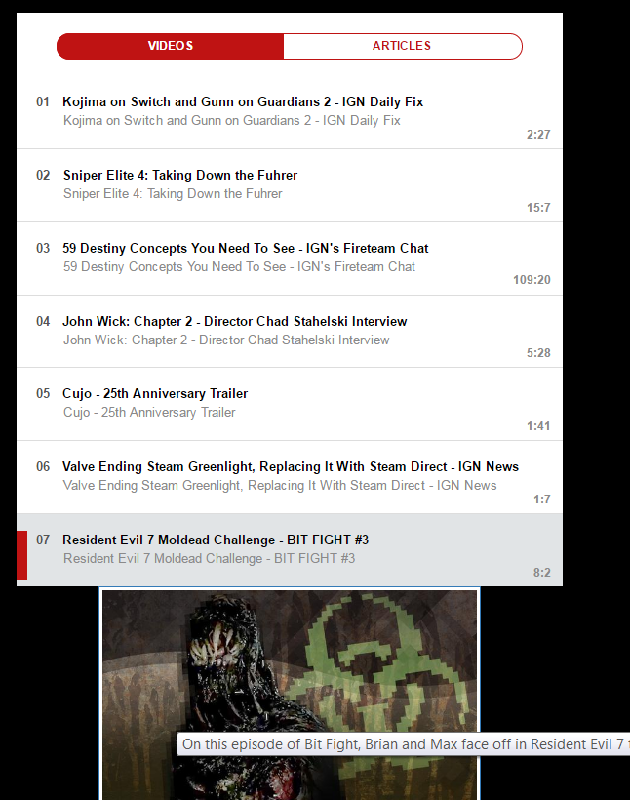
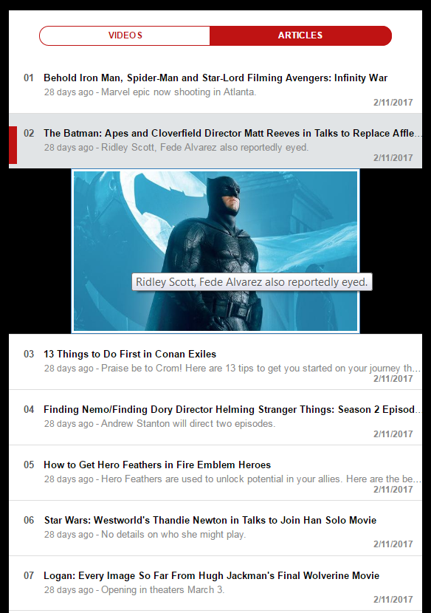
Demonstration
Videos View Articles View

Slide 12

Demonstration cont.

Slide 13




*Bonus Question
I decided to create my own Walking Dead themed game of Qwirkle. Unfortunately, I wasn’t able to complete the code in time so the game is not playable. However I will happily explain the rules and my thought process behind creating the game (although I do hope you are a Walking Dead fan to make things easier to understand ☺). I have also uploaded my source code to my GitHub repository.
Initially I was going to create a very custom game of Qwirkle where there were two factions each controlled by a player. There would be villains and heroes. I considered having different tiles such as the villains could place and match walker tiles while the heroes could only use “Alexandrian” or civilian tiles. I also considered adding special attack moves to my players that could only be used once certain conditions were met. An example would be “Negan can randomly kill any hero tile on the board but you must spend points saved from matching tiles” or “Michonne can kill all tiles within a row using her kitana by spending a certain amount of points”. I quickly realized although this sounded cool, I wasn’t going to have enough time to design and program it. Instead I opted for a more traditional version.

Slide 14


My Walking Dead themed Qwirkle would be very similar to the original game, except instead of differently shaped tiles there would be types of Walkers from the show (Spiked, Bleeding Eyes, Burnt, Floater, Bicycle, Riot Gear). These could be matched the same way as shapes in the original game. I also thought it would be fun to add in special character tiles representing both the heroes and villains of the series. These special tiles would have higher values and reward the player with a high score when matched with the right row of Walker tiles. The hero/villain tiles were:
1.Rick
value: 12 points
Needs: Spiked line
2.Michonne
value: 11 points
Needs: Bleeding Eyes line
3.Carol
value: 10 points
Needs: Burnt line
4.Glenn
value: 9 points
Needs: Floater line
5.Daryl
value: 8 points
Needs: Bicycle line
6.Carl
value: 7 points
Needs: Riot Gear line
1.Negan
value: 12 points
Needs: Spiked line
2.Governor
value: 11 points
Needs: Bleeding Eyes line
3.Gareth
value: 10 points
Needs: Burnt line
4.Shane
value: 9 points
Needs: Floater line
5.Dwight
value: 8 points
Needs: Bicycle line
6.Dawn
value: 7 points
Needs: Riot Gear line

Slide 15
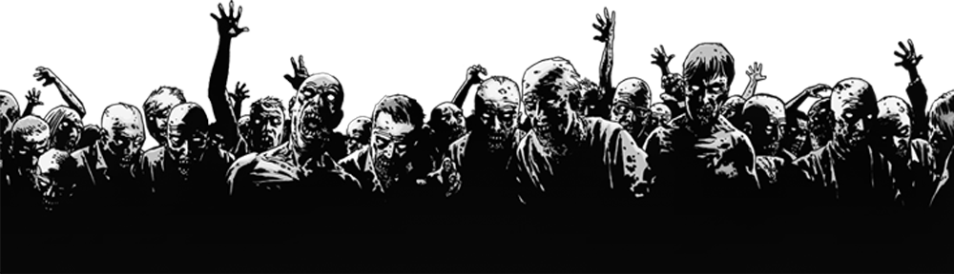
Preliminary Screenshot
I wanted to practice making a game which implements a Java frame window and makes the display more innovative for the user. I also wanted to practice button creation and action event handling. Although my code was incomplete, I hope this gives you an idea of how creative I can be and how much more I enjoy my work when it’s related to something I am passionate about. Here’s a look at what could have been.

Slide 16
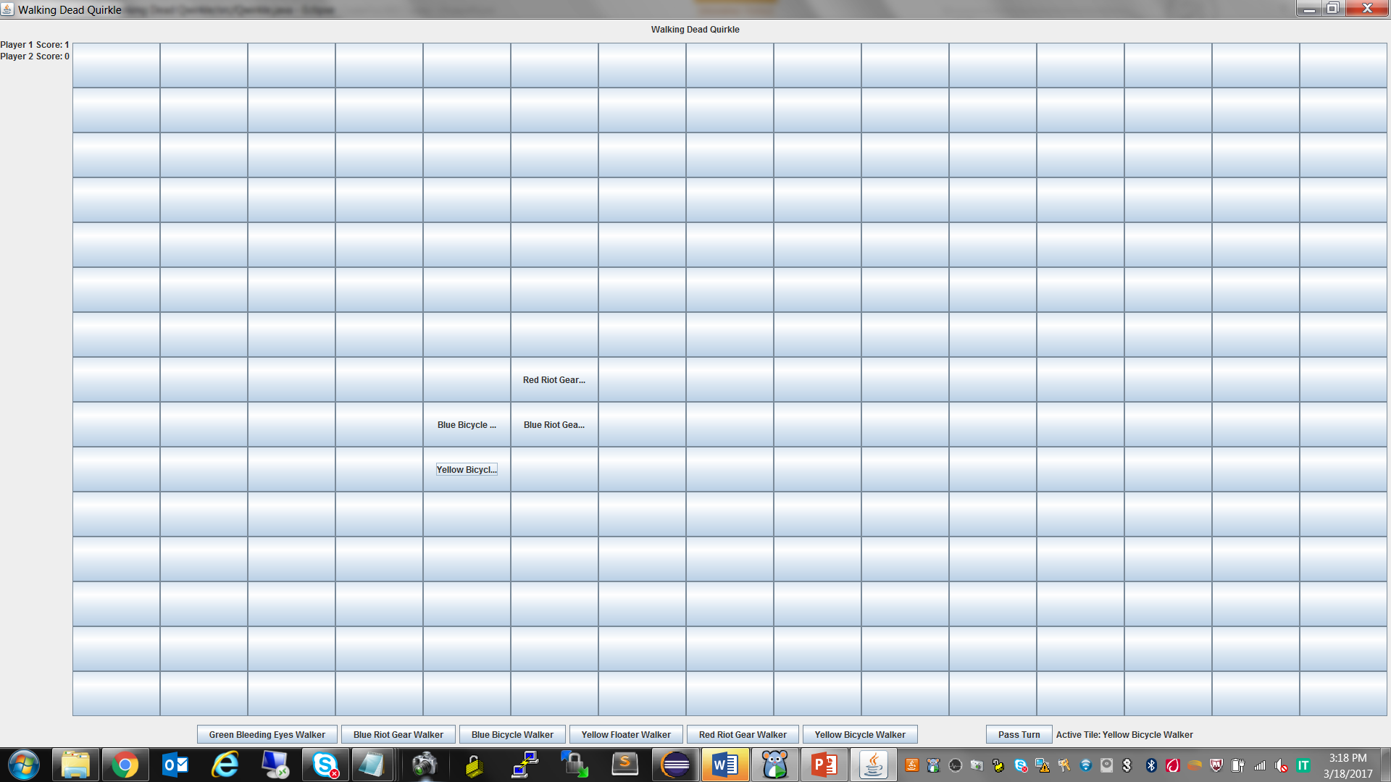

Slide 17
Thank you IGN!
Youtube Introduction: https://youtu.be/LJ3UExh3xR0
GitHub Source Code: https://github.com/Michaelgoku/IGN-Code-Foo-7
Repositories:
IGN_Code_Foo – Grid problem solver.
GridMenu.java
GridSolver.java
FrontEnd – Pull from API and display on web page front end problem.
CodeFoo.html
Jscript.js
Style.css
Bootstrap (not written by me but imported in CodeFoo.html)
Jquery (not written by me but imported in CodeFoo.html)
Walking Dead Qwirkle – Bonus Question
CharacterTile.java
GameMenu.java
Player.java
Qwirkle.java

